Slide 1
Supply Base Rationalization Revisited
Jerry Huff, PhD
Arizona State University
June 2019

Slide 2
Jerry Huff, PhD
Academic (Arizona State University)
PhD – Supply Chain Management (2016)
MBA (2008)
BS – Industrial Engineering (1999)
Professional
Intel Corporation (8 yrs)
SubZero Inc (4.5 yrs)
Arizona State University (5 yrs)
Avnet (3 yrs)
Teaching Experience
Supply Chain Management, General Business, Marketing, Management, Entrepreneurship

Slide 3
Agenda
Introduction
Data Source
Analysis Methodology
Conclusion

Slide 4
Supply base rationalization revisited
Material Flow
...
...
Information Flow
Financial Flow
Transition to network view (Borgatti and Li, 2009; Choi and Kim, 2008; Galaskiewicz, 2011)
Traditional buyer-supplier research (e.g. Agrawal and Nahmias, 1997; Ellram, 1990; Ogden and Carter, 2008)
This research analyzes supply base strategies over time

Slide 5
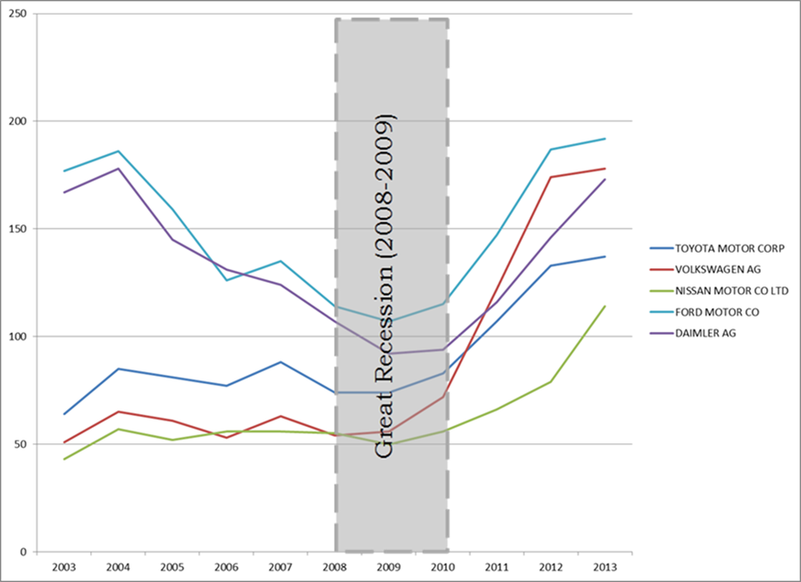
Supply base rationalization revisited
Great Recession (2008-2009)
Worldwide economy reduced $11 trillion USD (Roberts, 2009; Grusky et al, 2011)
Notes:
Great Recession:
Worldwide businesses, real estate, financial assets reduced $11 trillion USD (Roberts, 2009)
Changed labor markets, consumption patterns – even mortality and marriage rates (Grusky et al, 2011)
World trade feel by 25%-30% (Grusky et al, 2011)
Buyer-Supplier relationship impact?
Few studies on supply base management during the Great Recession (Krause and Ellram, 2014)
Post-recession strategies appear to be unacknowledged (Roh et al, 2014; Song et al, 2014)
Punctuated Equilibrium Theory (Eldridge and Gould, 1972)
Supply Base - the collection of suppliers that provide goods or services and are actively managed by the buying company (Choi and Krause, 2006)
Supply Base Management - various strategies used by firms to maximize their performance through their relationships with suppliers (Anderson et al, 2000; Choi and Hong, 2002; Hahn et al, 1990)
Supply Base Reduction – develop long-term, heavily inter-twined relationships between buying firms and a decreasing number of suppliers (Hartley and Choi, 1996; Ogden and Carter, 2008; Trent and Monczka, 1998)

Slide 6
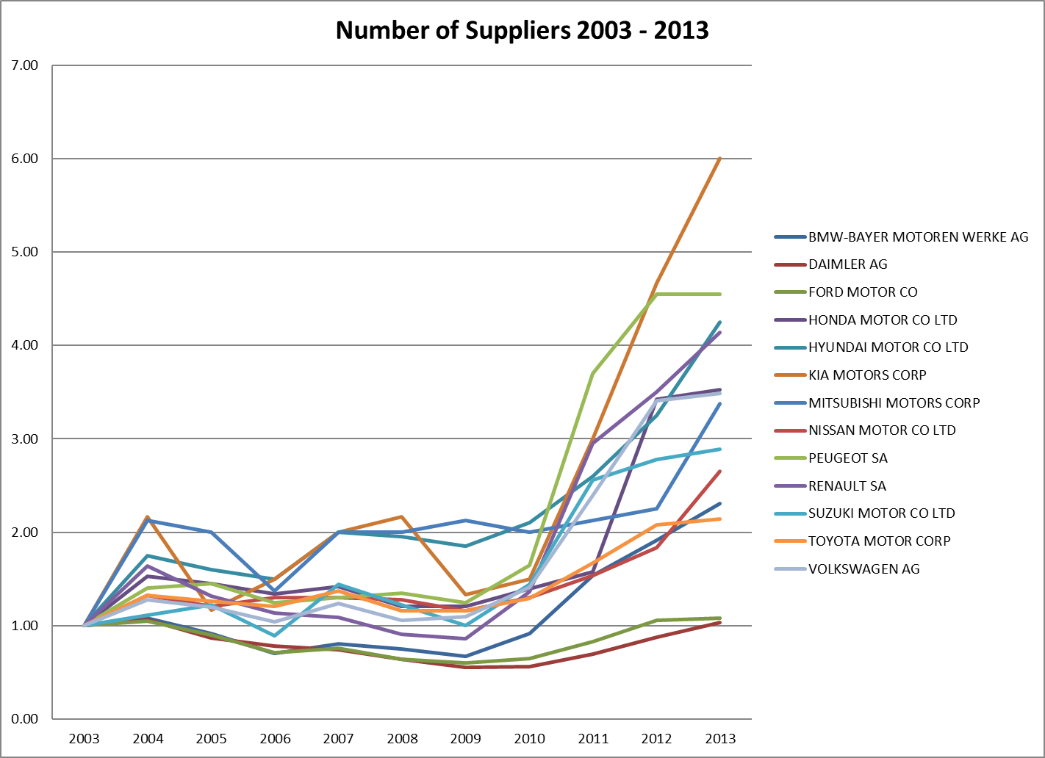
Supply base rationalization revisited
Great Recession (2008 – 2009)

Slide 7
Supply base rationalization revisited
Punctuated Equilibrium Theory (Eldridge and Gould, 1972)
Long periods of equilibrium separated by short periods of revolutionary upheaval
Research focus
Global auto industry (e.g.Carnovale and Yeniyurt, 2014; Choi and Kim, 2008; Gulati and Sytch, 2007; Helper, 1991)
Great Recession acts as disruptive event
SBM practices before 2008 vs after 2009
FactSet/Revere Supply Chain Relationships™ database
Longitudinal analysis of Supply Base Management strategies (Ramchandani, 2014)
Notes:
Buyer-Supplier relationship impact?
Few studies on supply base management during the Great Recession (Krause and Ellram, 2014)
Post-recession strategies appear to be unacknowledged (Roh et al, 2014; Song et al, 2014)
Punctuated Equilibrium Theory (Eldridge and Gould, 1972)
- Identified as a “promising underutilized theory” (Wowack and Boone, 2015) in JSCM
Supply Base - the collection of suppliers that provide goods or services and are actively managed by the buying company (Choi and Krause, 2006)
Supply Base Management - various strategies used by firms to maximize their performance through their relationships with suppliers (Anderson et al, 2000; Choi and Hong, 2002; Hahn et al, 1990)
Supply Base Reduction – develop long-term, heavily inter-twined relationships between buying firms and a decreasing number of suppliers (Hartley and Choi, 1996; Ogden and Carter, 2008; Trent and Monczka, 1998)

Slide 8
Supply base rationalization revisited
Research Question: How did buying firms’ SBM strategies change before and after the “Great Recession”?
H1: Prior to the Great Recession, the equilibrium state was supply base size reduction (i.e. negative association with time).
H2a: After the Great Recession, the equilibrium state becomes supply base expansion (i.e. positive association with time).
H2b: After the Great Recession, the equilibrium state becomes significantly faster supply base reduction (i.e. larger negative association with time).
H3: The number of suppliers in the first year after the Great Recession is significantly smaller than the number of suppliers in the last year before the Great Recession.

Slide 9
Supply base rationalization revisited
Research Question: How did buying firms’ SBM strategies change before and after the “Great Recession”?
Number of Suppliers
(pre-Recession)
H1
-
Number of Suppliers
(post-Recession)
H2a
+
Time
-
H2b
-
H3
Number of Suppliers
(during Recession)
Notes:
Research Question: How did buying firms’ SBM strategies change before and after the “Great Recession”?
H1: Prior to the Great Recession, the equilibrium state was supply base size reduction (i.e. negative association with time).
H2a: After the Great Recession, the equilibrium state becomes supply base expansion (i.e. positive association with time).
H2b: After the Great Recession, the equilibrium state becomes significantly faster supply base reduction (i.e. larger negative association with time).
H3: The number of suppliers in the first year after the Great Recession is significantly smaller than the number of suppliers in the last year before the Great Recession.

Slide 10
Supply base rationalization revisited

Slide 11
Supply base rationalization revisited
Accounts for over 85% of 2013 global auto production.
Notes:
NAICS 336111 (“Automobile Manufacturing”), NAICS code 336112 (“Light Truck and Utility Vehicle Manufacturing”), and SIC code 3711 (“Motor Vehicles and Car Bodies”). Total of 208 firms

Slide 12
Supply base rationalization revisited
Notes:
Represents more than 85% of all autos manufactured in 2013

Slide 13
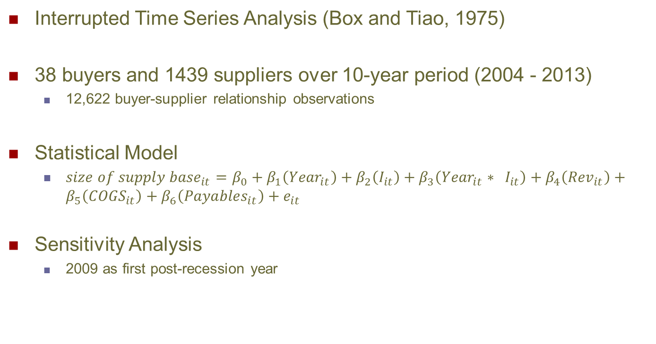
Supply base rationalization revisited
Interrupted Time Series Analysis (Box and Tiao, 1975)
38 buyers and 1439 suppliers over 10-year period (2004 - 2013)
12,622 buyer-supplier relationship observations
Statistical Model
${size of supply base}_{it}=β_{0}+β_{1}\left({Year}_{it}\right)+β_{2}\left(I_{it}\right)+β_{3}\left({{Year}_{it}∗ I}_{it}\right)+β_{4}\left({Rev}_{it}\right)+β_{5}\left({COGS}_{it}\right)+β_{6}\left({Payables}_{it}\right)+e_{it}$
Sensitivity Analysis
2009 as first post-recession year
Notes:
Analysis done in SAS v9.4
Mixed linear model with AutoRegressive1 (“ar1”) link function
H1 – supports the view of Supply Base Reduction before Great Recession
H2a – shows shift to Supply Base Expansion after Great Recession
H3 – shows no difference in supply base size last year before recession to first year after recession
No change if 2009 is first “post-recession” year

Slide 14
Supply base rationalization revisited
Change in Number of Suppliers over time

Slide 15
Supply base rationalization revisited
Research Question: How did buying firms’ SBM strategies change before and after the “Great Recession”?
Number of Suppliers
(pre-Recession)
H1 – Supported
-
Number of Suppliers
(post-Recession)
H2a – Supported
+
Time
-
H2b – not supported
-
H3 – not supported
Number of Suppliers
(during Recession)
Notes:
H1 – Prior to 2008, Supply Base Reduction supported ($β_{1}$=-3.8059, p=0.0003)
H2a – After 2010, Supply Base Expansion supported ($β_{1}+β_{3}$ = 8.4386, p<0.0001)
H2b – After 2010, increased Supply Base Reduction not supported
H3 – During Great Recession, reduced Supply Base not supported ($β_{2}$=-4.1937, p=0.0846)
No change in results if 2009 is first post-recession year

Slide 16
Supply base rationalization revisited

Slide 17
Supply base rationalization revisited
Prior to 2008, SBM strategies focused on Supply Base Reduction
After 2009, SBM strategies changed to Supply Base Expansion
Supply base size same just before vs just after Great Recession
By 2012, supply bases larger than 2004 – and growing!
Limitation 1 – 38 firms in auto industry only
Limitation 2 – Large, multinational firms only
Limitation 3 – FactSet relationships not exhaustive
Notes:
Most importantly, our results demonstrate a clear shift in SBM strategy embraced by practicing managers, yet mostly unacknowledged in the academic literature.
However, utilizing the analytical approach of interrupted time series analysis on a unique longitudinal dataset, our results demonstrate that practicing managers have clearly changed their SBM strategies after the Great Recession.

Slide 18
Contributions
Academic
Introduction of longitudinal data to buyer-supplier network research
Proposed challenge to traditional Supply Base Rationalization
Managerial
Recognition that supply base management strategy shift
Supply chain risk gaining importance after Recession
Extensions:
Does network structure change as well as network size?
Are same phenomena present in other industries?
Characteristics of “surviving” suppliers?
Supplier switching or re-engagement?
Notes:
This dissertation research focuses on how the dynamics of the supply network change over time and impact firm performance.
We expand the definition of the supply network to include the competitors of the buying firm as well as their suppliers. This expanded competitive network view provides a more realistic understanding of the environment in which competitor firms operate.
By investigating the structural changes in the many-to-many relationships within the competitive network, this research highlights that the focal firm is not centrally controlling the characteristics of its network.
We also propose a new network metric to capture the importance of a firm’s supply base within the competitive network. Based upon the concept of power/dependence in buyer-supplier relationships, our metric of supply base power offers another aspect to be included in risk evaluations.

Slide 19
Thank you!

Slide 20
References
Agrawal, N., Nahmias, S., 1997. Rationalization of the Supplier Base in the Presence of Yield Uncertainty. Production and Operations Management 6, 291–308.
Arya, B., Lin, Z., 2007. Understanding Collaboration Outcomes From an Extended Resource-Based View Perspective: The Roles of Organizational Characteristics, Partner Attributes, and Network Structures†. Journal of Management 33, 697–723. doi:10.1177/0149206307305561
Bellamy, M.A., Ghosh, S., Hora, M., 2014. The influence of supply network structure on firm innovation. Journal of Operations Management 32, 357–373. doi:10.1016/j.jom.2014.06.004
Borgatti, S.P., Li, X., 2009. On Social Network Analysis in a Supply Chain Context*. Journal of Supply Chain Management 45, 5–22.
Box, G.E.P., Tiao, G.C., 1975. Intervention Analysis with Applications to Economic and Environmental Problems. Journal of the American Statistical Association 70, 70. doi:10.2307/2285379
Burt, R.S., 1992. Structural holes: the social structure of competition. Harvard University Press, Cambridge, Mass.
Carnovale, S., Yeniyurt, S., 2014. The Role of Ego Networks in Manufacturing Joint Venture Formations. Journal of Supply Chain Management 50, 1–17.

Slide 21
References
Choi, T.Y., Kim, Y., 2008. Structural Embeddedness and Supplier Management: A Network Perspective*. Journal of Supply Chain Management 44, 5–13.
Coleman, J.S., 1988. Social Capital in the Creation of Human Capital. American Journal of Sociology 94, S95–S120. doi:10.2307/2780243
Dyer, J.H., Hatch, N.W., 2004. Using Supplier Networks to Learn Faster. MIT Sloan Management Review 45, 57–63.
Eldridge, N., Gould, S.J., 1972. Punctuated equilibria: An alternative to phyletic gradualism, in: Models in Paleobiology. Freeman, Cooper & Co., San Francisco, pp. 82–115.
Ellram, L.M., 1990. The Supplier Selection Decision in Strategic Partnerships. International Journal of Purchasing and Materials Management 26, 8.
Emerson, R.M., 1962. Power-Dependence Relations. American Sociological Review 27, 31–41. doi:10.2307/2089716
Galaskiewicz, J., 2011. Studying Supply Chains from a Social Network Perspective. Journal of Supply Chain Management 47, 4–8. doi:10.1111/j.1745-493X.2010.03209.x
Grusky, D.B., Western, B., Wimer, C.C., 2011. The Great Recession. Russell Sage Foundation.

Slide 22
References
Gulati, R., Sytch, M., 2007. Dependence asymmetry and joint dependence in interorganizational relationships: Effects of embeddedness on a manufacturer’s performance in procurement relationships. Adm. Sci. Q. 52, 32–69.
Gupta, S., Dutta, K., 2011. Modeling of financial supply chain. European Journal of Operational Research 211, 47–56. doi:10.1016/j.ejor.2010.11.005
Helper, S., 1991. Strategy and Irreversibility in Supplier Relations: The Case of the U.S. Automobile Industry. The Business History Review 65, 781–824. doi:10.2307/3117265
Huff, J., Rogers, D.S., 2015. Funding the Organization through Supply Chain Finance: A Longitudinal Investigation. Supply Chain Forum: An International Journal 16, 4–17. doi:10.1080/16258312.2015.11716348
Jose, M., Lancaster, C., Stevens, J., 1996. Corporate Returns and Cash Conversion Cycles. Journal of Economics and Finance 21, 33–46.
Ogden, J.A., Carter, P.L., 2008. The supply base reduction process: an empirical investigation. The International Journal of Logistics Management 19, 5–28. doi:10.1108/09574090810872578
Roberts, M., 2009. The Great Recession. Lulu.com.
Ramchandani, A., 2014. Incorporating Bidirectional Momentum Effects and Media Attention to Profitably Trade Economically Linked Companies.

Slide 23
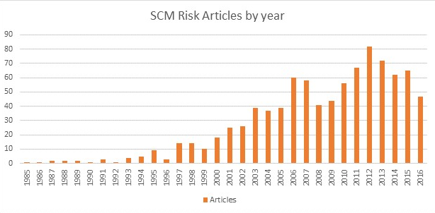
Supply base rationalization revisited

Slide 24
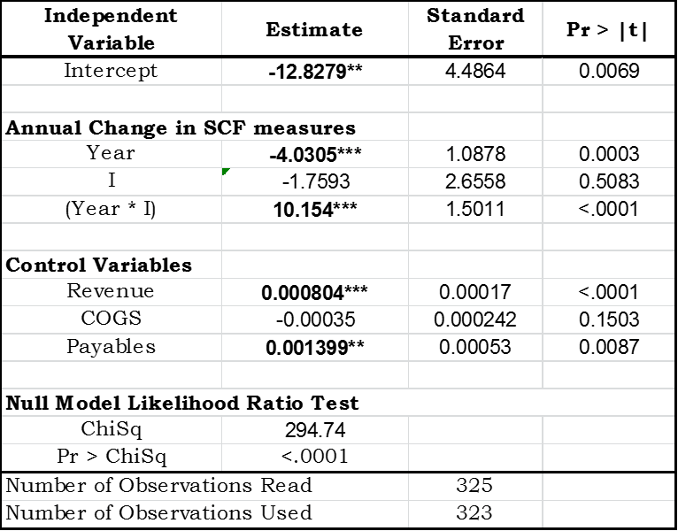
Supply base rationalization revisited
Change in Number of Suppliers over time with 2009 as first post-recession year

